Slide 1
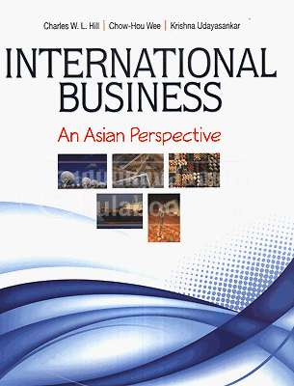
INTERNATIONAL BUSINESS
An Asian Perspective
Hill / Wee /Udayasankar

Slide 2
About the BOOK
Part one
Introduction
Chapter 1 Globalization
Part two
Country Differences
Chapter 2 National Differences in Political Economy
Part three
The Global Trade and Investment Environment
Chapter 5 International Trade Theory
Chapter 3 Differences in Culture
Chapter 4 Ethics in International Business
Chapter 6 The Political Economy of International trade
Chapter 7 Foreign Direct Investment
Chapter 8 Regional Economic Integration

Slide 3
About the BOOK
Part four
The Global Monetary System
Chapter 9 The Foreign Exchange Market
Part five
The Strategy and Structure of International Business
Chapter 12 The Strategy of International Business
Part six
The Global Trade and Investment Environment
Chapter 15 Exporting, Importing, and Countertrade
Chapter 13 The Organization of International Business
Chapter 14 Entry Strategy and Strategic Alliances
Chapter 16 Global Production, Outsourcing, and Logistics
Chapter 17 Global Marketing and R&D
Chapter 18 Global Human Resource Management
Chapter 10 The International Monetary System
Chapter 11 The Global Capital Market
Chapter 19 Accounting in the International Business
Chapter 20 Financial Management in the International Business

Slide 4
CHAPTER 3
Differences in Culture

Slide 5
Topics
Meaning of culture
Forces that lead to differences in social culture
The business and economic implications of differences in culture
How differences in social culture influence values in the workplace
An appreciation for the economic and business implications of cultural change

Slide 6
Introduction
The first theme
The second theme
Business success in a variety of countries requires cross-cultural literacy.
A relationship between culture and the cost of doing business in a country.

Slide 7
What Is Culture?
“the collective programming of the mind which distinguishes the members of one human group from” (Greet Hofstede)
“A system of ideas and argue that these ideas constitute a design for living” (Zvi Namenwirth and Robert Weber)

Slide 8
What Is Culture?
Culture
Values
Norms
Folkways
Mores
Society

Slide 9
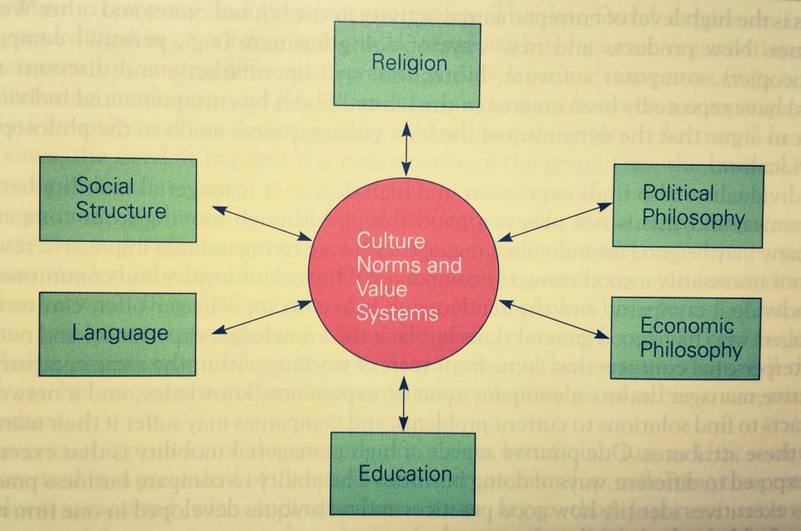
THE DETERMINANTS OF CULTURE

Slide 10
Social Structure
The Individual
The group

Slide 11
Social Structure (cont’)
SOCIAL STRATIFICATION
Social Mobility
Class system
Significance
Class consciousness

Slide 12
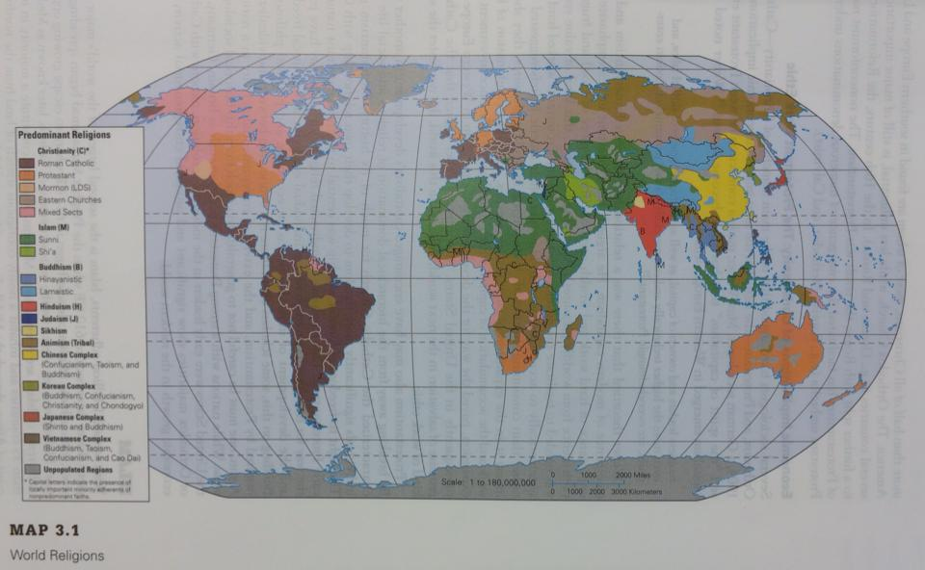
Religious and Ethical Systems

Slide 13
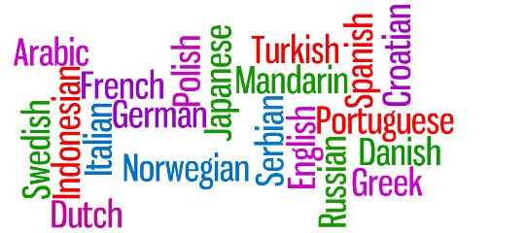
Language
SPOKEN LANGUAGE
UNSPOKEN LANGUAGE

Slide 14
Education
Culture and the Workplace
Power distance
Uncertainty avoidance
Individualism vs collectivism
Masculinity vs femininity

Slide 15
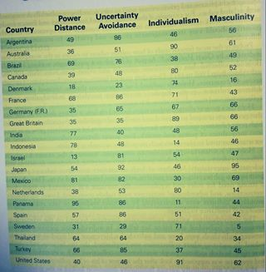
Culture and the workplace

Slide 16
Thank you very much for your attention

